Slide 1
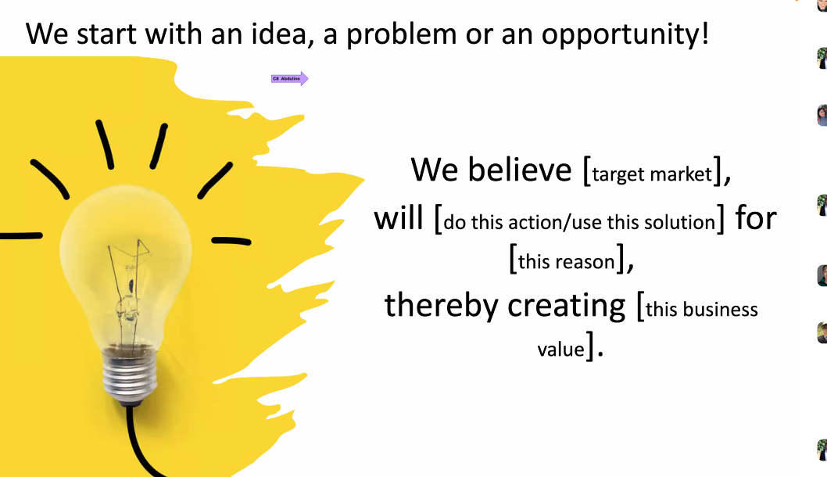
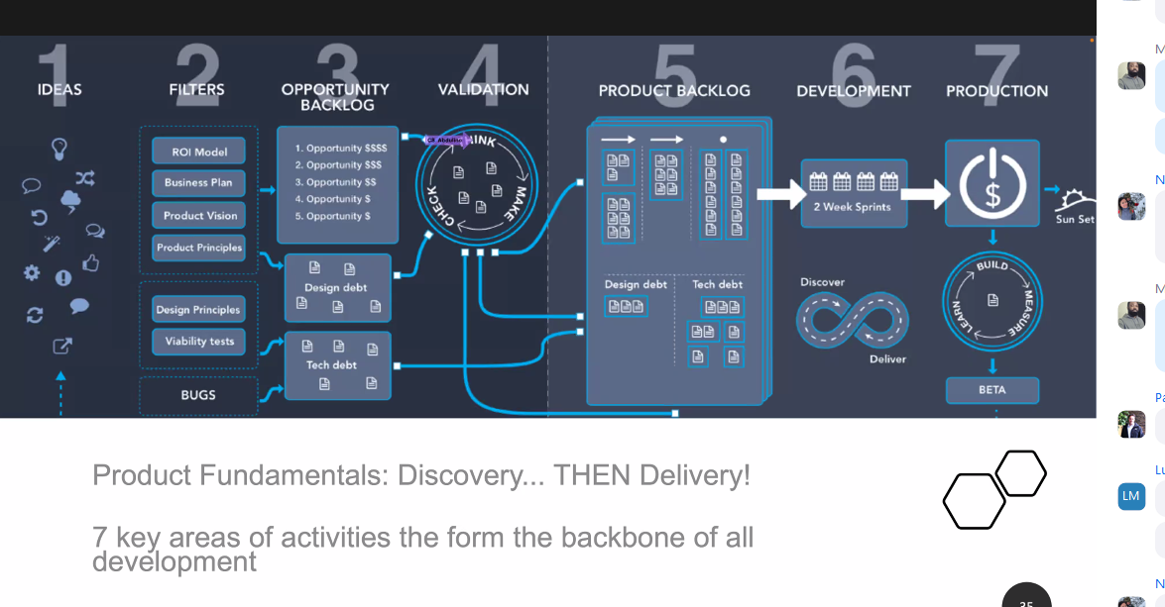

Slide 2
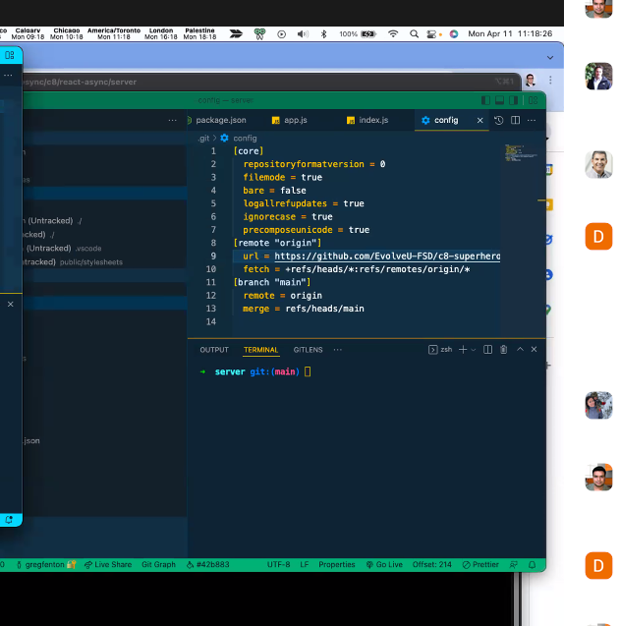
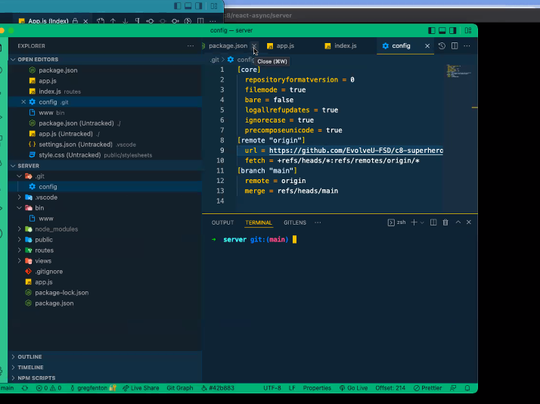
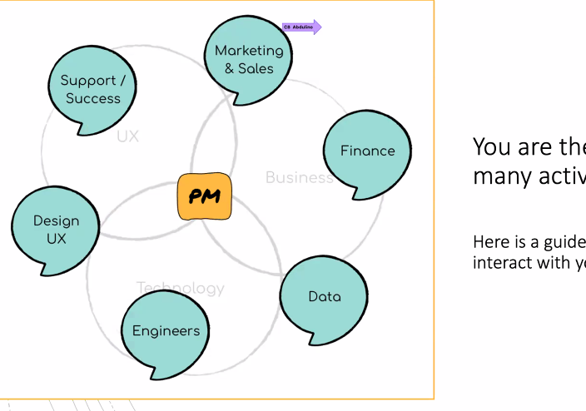
Log-in screen (user registration)
Dynamic functionalities – redux
Idea:
How might people get advice on location for a home purchase? (helping people get a one-stop-shop data center to take decisions on locations for rental or home purchase)
Get community crime and disorder statistics
Traffic incidents
Building permits
Property assessments
Alberta Township Sections
Development Permits
School locations/ and community maps
Major Road Network
Calgary Transit Routes
Hydrology
Police Service Location
Traffic Volumes for 2018
Street Names
Natural Vegetation
Transit LRT Stations
1:100 Flood Map (1% chance of occurring in any year)
Calgary Bikeways
2021 Assessed Property Values
Building Permit Locations

Slide 3
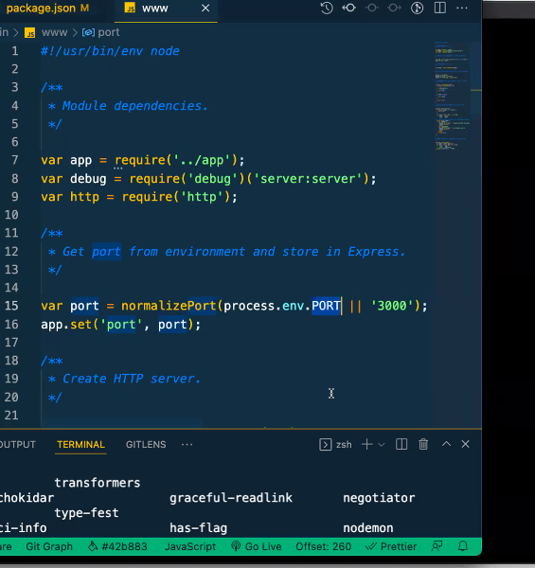
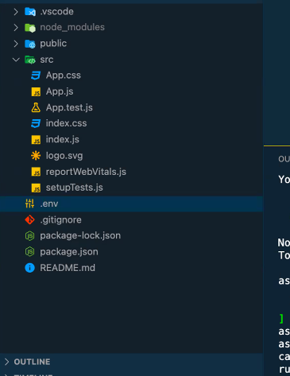
How might people get advice on location for a home purchase or rental? (helping people get a one-stop-shop data center to take decisions on locations for rental or home purchase) => {buy/rent = user’s choice-based *
Get community crime and disorder statistics
Traffic incidents
Building permits
Property assessments
Alberta Township Sections
Development Permits
School locations/ and community maps
Major Road Network
Calgary Transit Routes
Hydrology
Police Service Location
Traffic Volumes for 2018
Street Names
Natural Vegetation
Transit LRT Stations
1:100 Flood Map (1% chance of occurring in any year)
Calgary Bikeways
2021 Assessed Property Values
Building Permit Locations

Slide 4
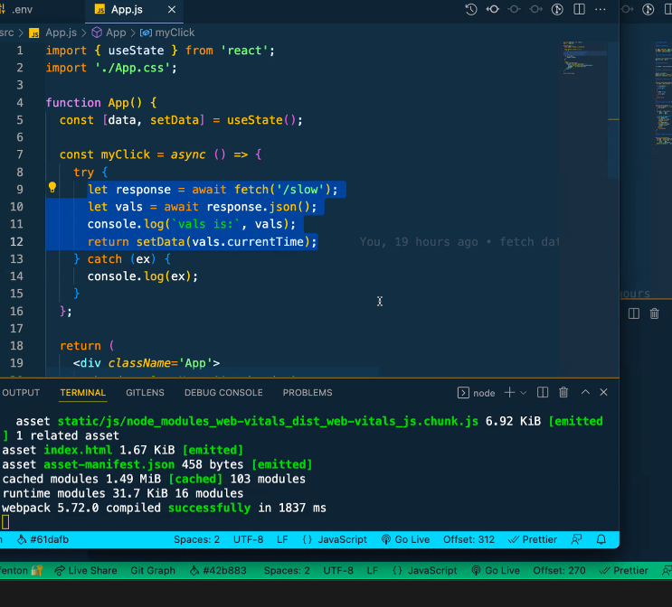
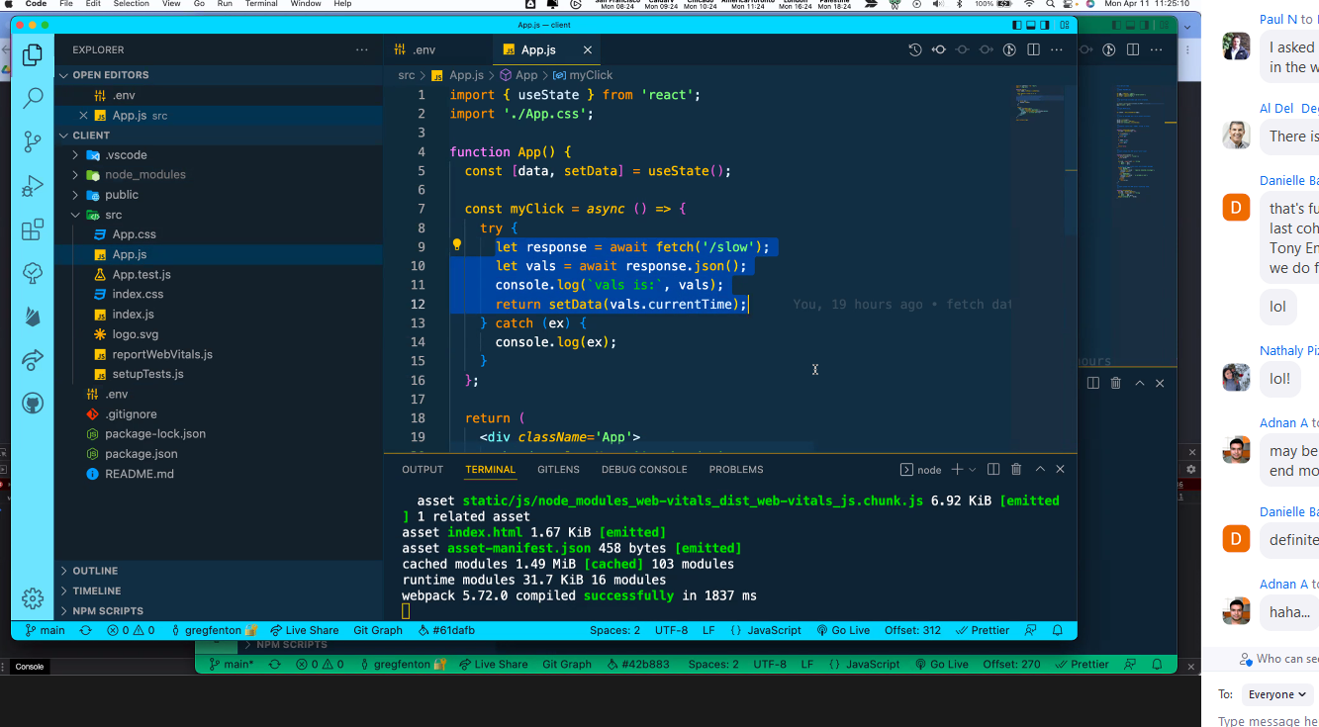
Parks Pathways
Community Services
Building permits
Recreation Facilities
Parks Sites
Off Leash Dog Area Locations
Travel Times
Calgary Transit Routes and Stops
Recreation Facilities
Calgary Health Clinics and Hospitals
Fire Stations
Major Road Network
EMS Stations
2022 Assessed Property Values
Annual crime statistics per community
Historical Calgary Community Populations})

Slide 5
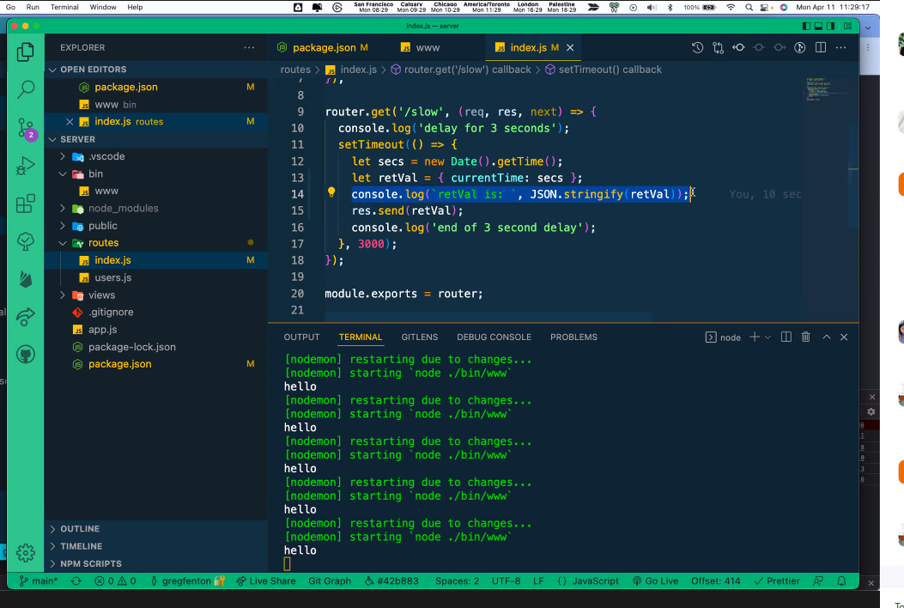
Create React JS Frontend App
Step 1 – Create React App
Step 2 – Install validator and Bootstrap
Step 3 – Create Form Validation Class
Step 4 – Create Registration Form in App.js
Create Node JS Express Backend
Step 5 – Create Node Js App
Step 6 – Create Table In Database
Step 7 – Install Express body parser cors and MySQL Dependencies
Step 8 – Create Apis in Server JS File
Step 9 – Start Node Js Express App

Slide 6
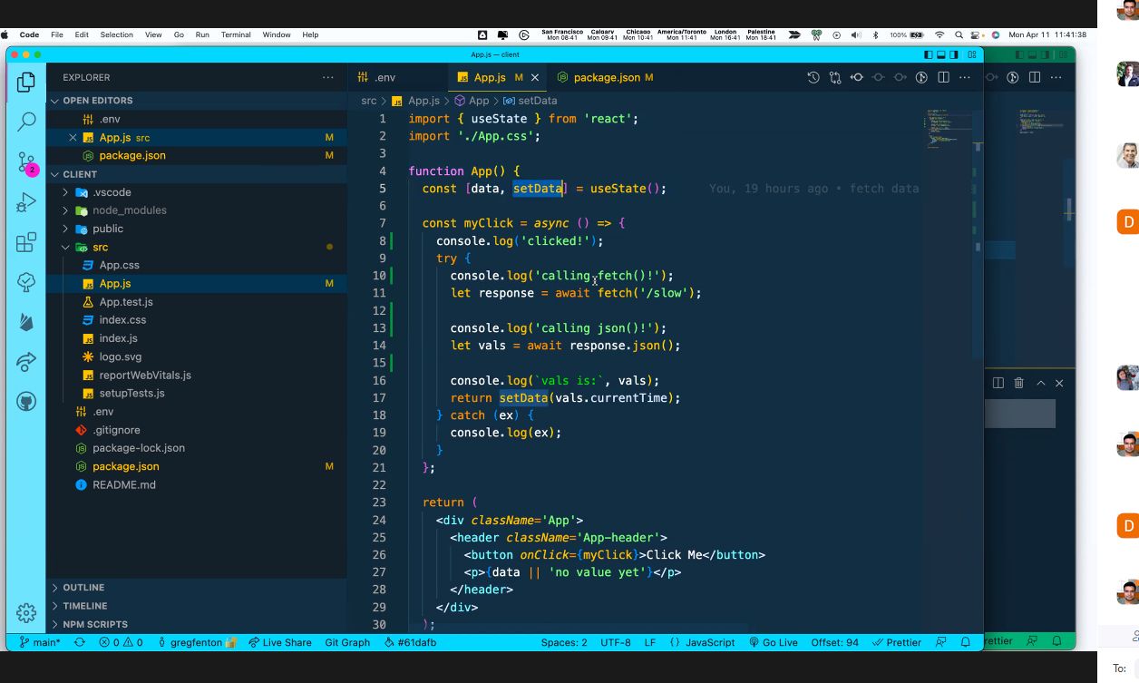
a file db.config.js is used to define MySQL database configuration with Sequelize ORM
a file customer.model.js is used to define a Sequelize model mapped with corresponding MySQL database table schema.
a file router.js is used to define all Express RestAPI URLs
a file controller.js is used to implement detail logic code to process each incoming request
a file server.js is used to implement a Nodejs Web server

Slide 7
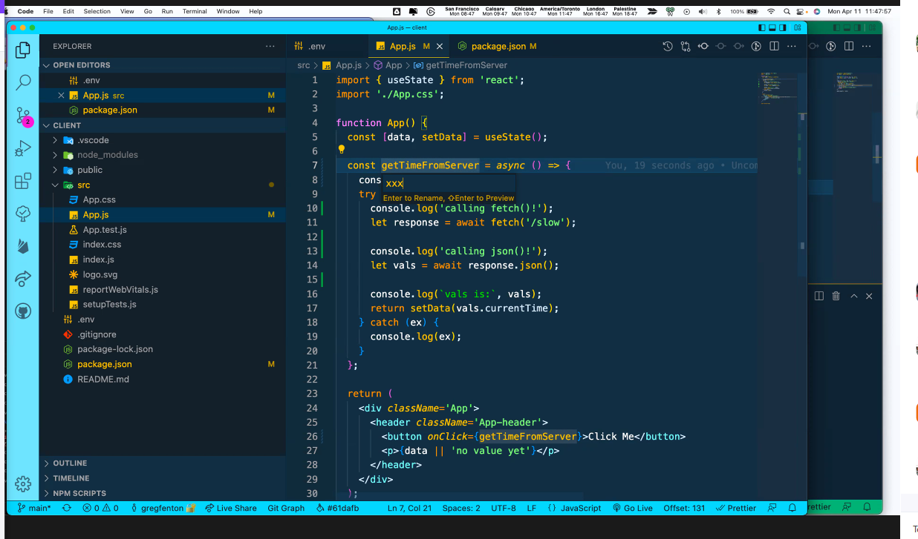
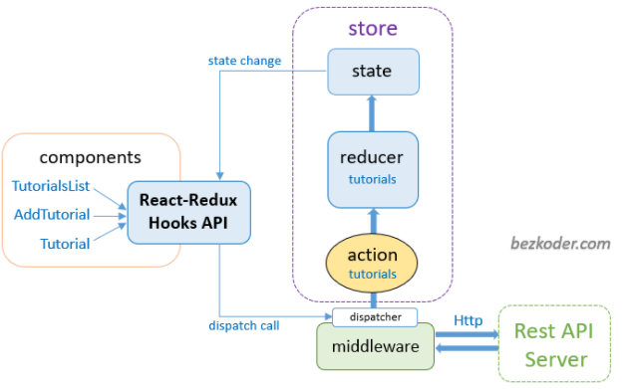

Slide 8
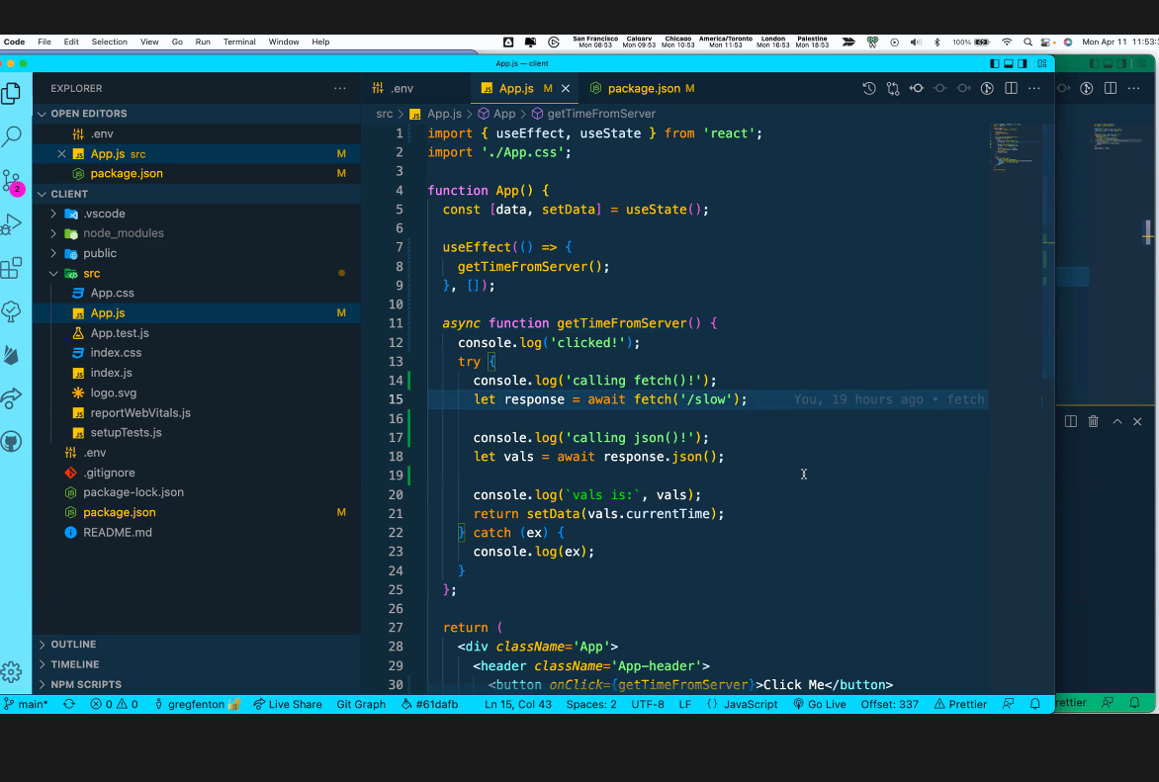
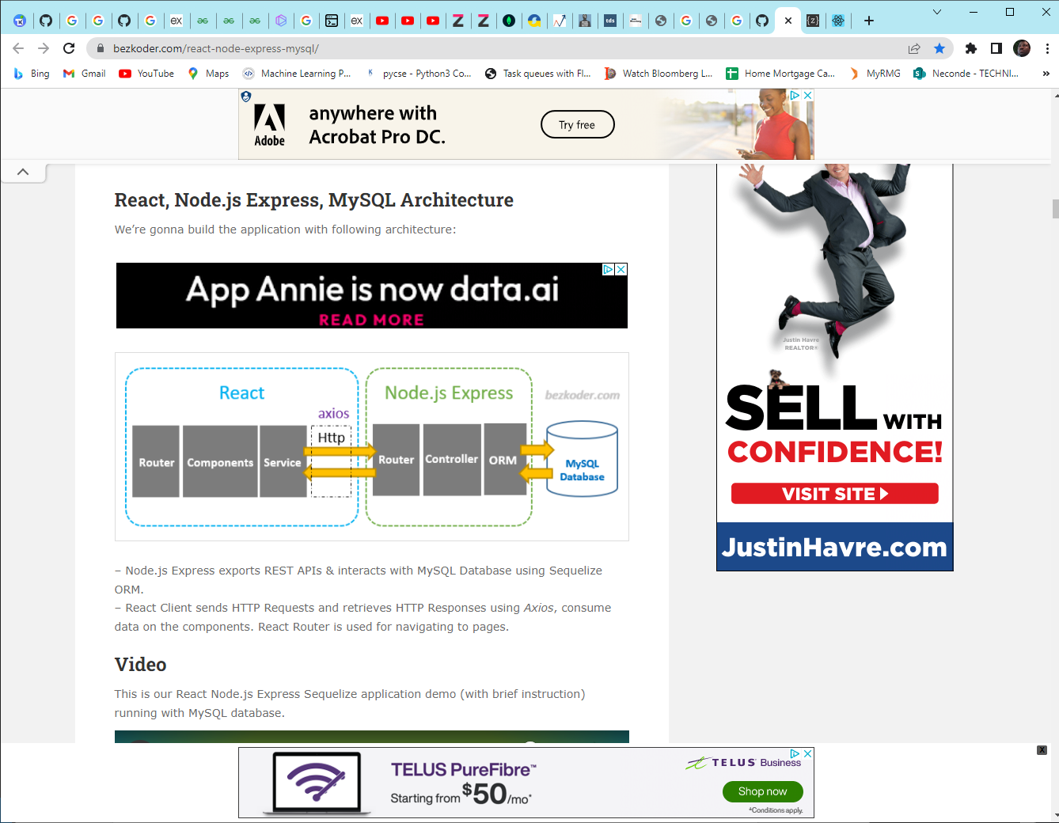

Slide 9
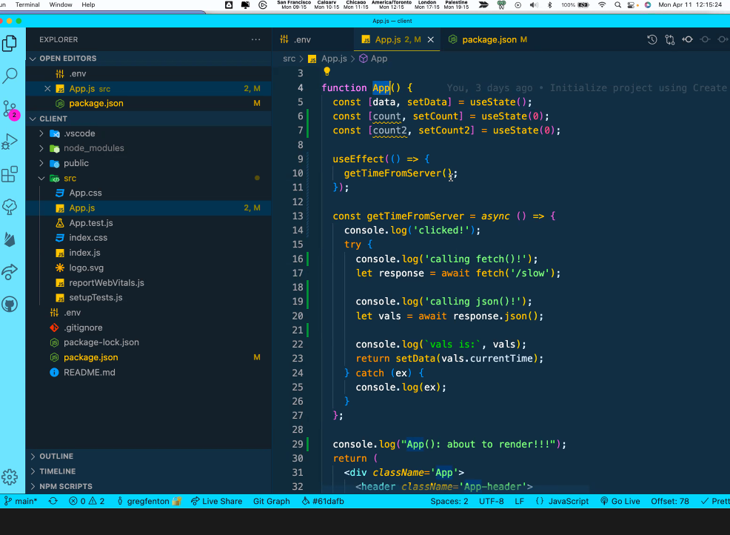
import React from 'react';import { createRoot } from 'react-dom/client';import './index.css';import App from './App';import reportWebVitals from './reportWebVitals';const root = createRoot(document.getElementById('root'));root.render( <React.StrictMode> <App /> </React.StrictMode>);// If you want to start measuring performance in your app, pass a function// to log results (for example: reportWebVitals(console.log))// or send to an analytics endpoint. Learn more: https://bit.ly/CRA-vitalsreportWebVitals();

Slide 10
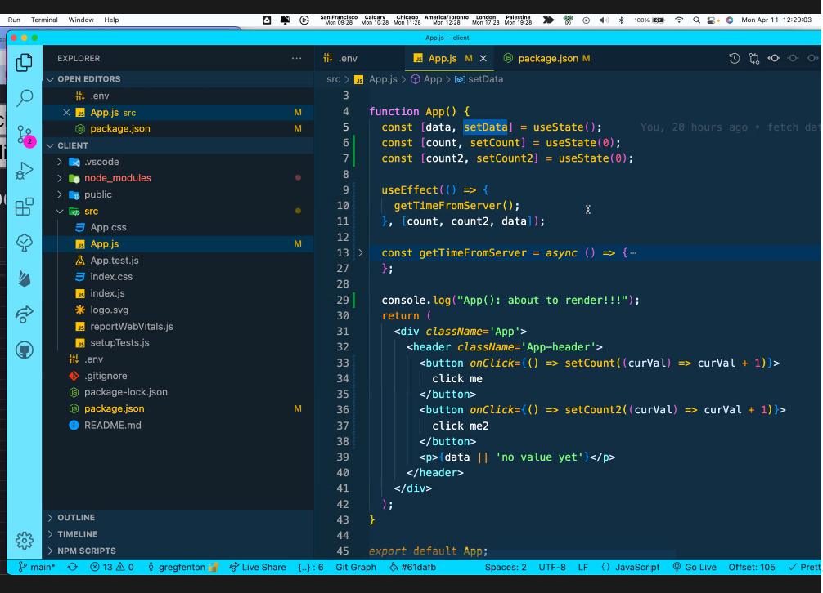

Slide 11
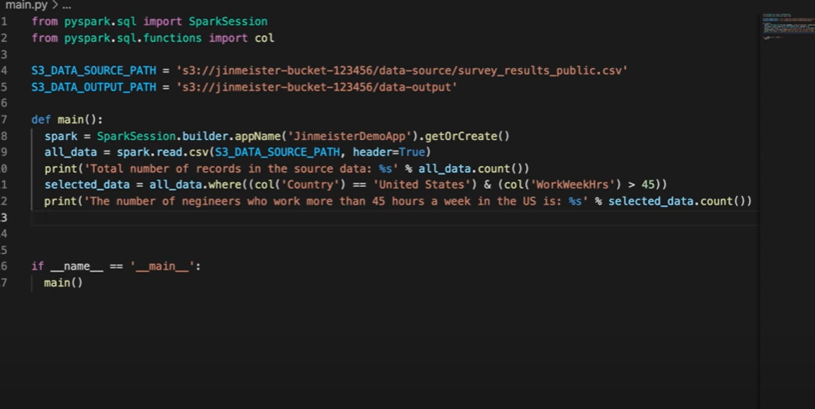

Slide 12
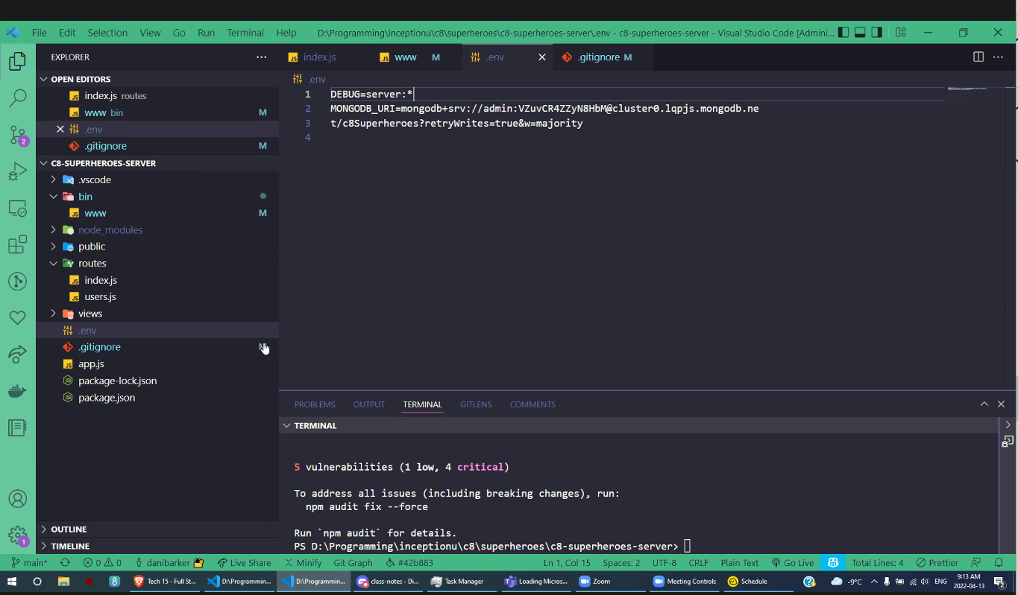

Slide 13
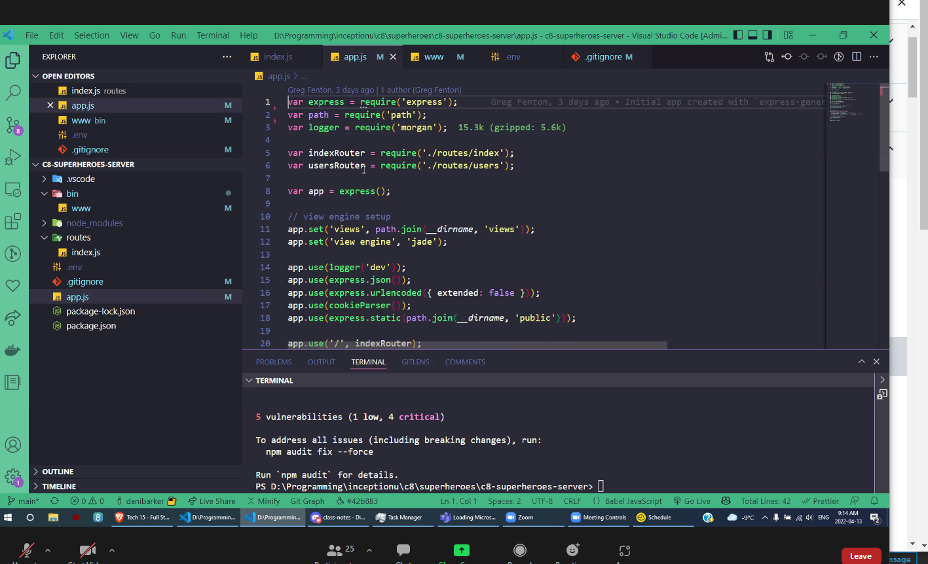

Slide 14
const mongoose = require("mongoose");require("dotenv").config();const connectionString = process.env.MONGODB_URI || "mongodb://localhost:27017/mongoose-test";mongoose.connect(connectionString, () => { console.log(`connected to mongoose on ${connectionString}`);});

